Slide 1

CSE310: Programming in Java
Topic: Array and Enum

Slide 2
Outlines
Introduction
Array Creation
Array Initialization
Enumerations

Slide 3
Array
Definition:
An array is a finite collection of variables of the same type that are referred to by a common name.
Arrays of any type can be created and may have one or more dimensions.
A specific element in an array is accessed by its index (subscript).
Array elements are stored in contiguous memory locations.
Examples:
  Collection of numbers
  Collection of names

Slide 4
More points
In Java all arrays are dynamically allocated.
Since arrays are objects in Java, we can find their length using the object property length.
The direct superclass of an array type is Object.
If we try to access array outside of its index then ArrayIndexOutOfBounds Exception will be raised

Slide 5
One-Dimensional Arrays
A one-dimensional array is a list of variables of same type.
The general form of a one-dimensional array declaration is:
type [] arr_ref_var; OR
type [] arr_ref_var= new type[size];
Example:
int [] num = new int [10];
It will create an array of 10 integers.

Slide 6
Syntax and Example
Declaration of array variable:
data-type variable-name[];
eg. int marks[];
This will declare an array named ‘marks’ of type ‘int’. But no memory is allocated to the array.
Allocation of memory:
variable-name = new data-type[size];
eg. marks = new int[5];
This will allocate memory of 5 integers to the array ‘marks’ and it can store upto 5 integers in it. ‘new’ is a special operator that allocates memory.

Slide 7
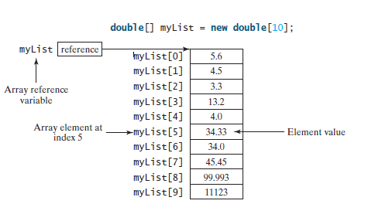
Another Example of array

Slide 8
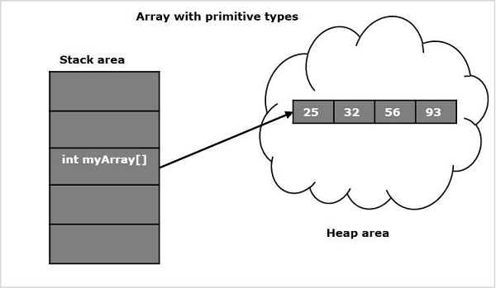
Memory allocation

Slide 9
Accessing elements in the array:
Specific element in the array is accessed by specifying name of the array followed the index of the element.
All array indexes in Java start at zero.
variable-name[index] = value;
Example:
marks[0] = 10;
This will assign the value 10 to the 1st element in the array.
marks[2] = 863;
This will assign the value 863 to the 3rd element in the array.

Slide 10
Example
STEP 1 : (Declaration)
int marks[];
marks → null
STEP 2: (Memory Allocation)
marks = new int[5];
marks →
marks[0] marks[1] marks[2] marks[3] marks[4]
STEP 3: (Accessing Elements)
marks[0] = 10;
marks →
marks[0] marks[1] marks[2] marks[3] marks[4]
0 | 0 | 0 | 0 | 0
10 | 0 | 0 | 0 | 0

Slide 11
Size of an array can’t be changed after the array is created.
Default values:
  zero (0) for numeric data types,
  \u0000 for chars and
  false for Boolean types
  Length of an array can be obtained as: array_ref_var.length

Slide 12
Examples…
// to show the working of single dimension array
class Example
{
public static void main(String args[])
{
int a[] = new int[5];
a[0]=12;a[1]=34;a[2]=56;a[3]=78;a[4]=90;
System.out.println("Length of the array is "+a.length);
System.out.println("Printing the elements of array");
for(int i=0;i<a.length;i++)
System.out.println(a[i]);
}
}

Slide 13
// Proigram to show the working of single dimension array
import java.util.Scanner;
class Test {
public static void main(String args[]) {
int n;// number of elements in array
Scanner ob = new Scanner(System.in);
System.out.println("Enter the number of elements in array");
n = ob.nextInt();
int a[] = new int[n]; // <<<<<<ARRAY
System.out.println("Enter" + n + "elements of array");
for (int i = 0; i < a.length; i++) {
a[i] = ob.nextInt();
}
System.out.println("Printing the elements of array");
for (int i = 0; i < a.length; i++) {
System.out.println(a[i]);
}
}
}

Slide 14
Note
Arrays can store elements of the same data type. Hence an int array CAN NOT store an element which is not an int.
Though an element of a compatible type can be converted to int and stored into the int array.
eg. marks[2] = (int) 22.5;
This will convert ‘22.5’ into the int part ‘22’ and store it into the 3rd place in the int array ‘marks’.
Array indexes start from zero. Hence ‘marks[index]’ refers to the (index+1)^{th} element in the array and ‘marks[size-1]’ refers to last element in the array.

Slide 15
For an array of the char[] type, it can be printed using one print statement. For example, the following code displays Dallas:
char[] city = {'D', 'a', 'l', 'l', 'a', 's'};
System.out.println(city);
Accessing an array out of bounds is a common programming error that throws a runtime ArrayIndexOutOfBoundsException. To avoid it, make sure that you do not use an index beyond arrayRefVar.length – 1.

Slide 16
Array Initialization
data Type [] array_ref_var = {value0, value1, …, value n};
data Type [] array_ref_var = new data Type [n];
array_ref_var [0] = value 0;
array_ref_var [1] = value 1;
…
array_ref_var [n-1] = value n;
3. data type [] array_ref_var = new int[] {value1,value 2..}

Slide 17
Array initialization: Example
class Example
{
public static void main(String args[])
{
int [] a = new int [] {1,2,3,4,5};
for(int i : a)
System.out.println(i);
}
}

Slide 18
Printing array elements using for each loop
We can also print the Java array using for-each loop. The Java for-each loop prints the array elements one by one. It holds an array element in a variable, then executes the body of the loop.
The syntax of the for-each loop is given below:
for(data_type variable:array)
{
//body of the loop
}

Slide 19
Example 1
class Example
{
public static void main(String args[])
{
int arr[]={33,3,4,5};
//printing array using for-each loop
for(int i:arr)
System.out.println(i);
}
}

Slide 20
Example 2
import java.util.Scanner;
class Example
{
public static void main(String args[])
{
int i;
String s[] = new String[5];
Scanner ob = new Scanner(System.in);
System.out.println("Enter the 5 strings");
for(i=0;i<s.length;i++)
s[i]=ob.nextLine();
System.out.println("5 strings are");
for(String x : s)
System.out.println(x);
}
}

Slide 21
Exercise
Write a program which prompts the user to enter the number of elements.
Now read the marks of all the subjects from the user using Scanner class.
Write a method which calculates the percentage of the user.

Slide 22
Multi-Dimensional Array
Multidimensional arrays are arrays of arrays(2D,3D….)
Two-Dimensional arrays are used to represent a table or a matrix.
A two-dimensional array is actually an array in which each element is a one-dimensional array.
Declaration:
elementType[][] arrayRefVar; or elementType arrayRefVar[][];
Example: int[][]a; or int a[][];
Creating 2D array:
elementType[][] arrayRefVar=new elementType[n][m];
Example:
int twoD[][] = new int[4][5];

Slide 23
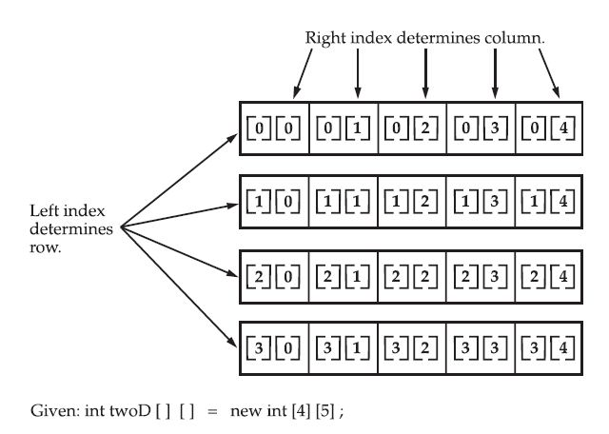
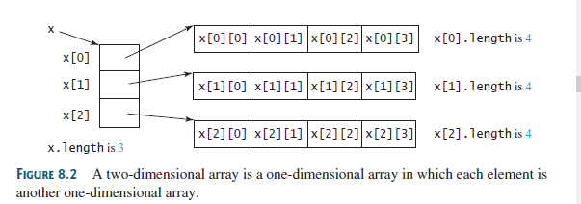
Conceptual View of 2-Dimensional Array

Slide 24
class TwoDimArr
{
public static void main(String args[])
{
int twoD[][]= new int[4][5];
int i, j, k = 0;
for(i=0; i<4; i++)
for(j=0; j<5; j++)
{
twoD[i][j] = k;
k++;
}
for(i=0; i<4; i++)
{
for(j=0; j<5; j++)
System.out.print(twoD[i][j] + " ");
System.out.println();
}
}
}
Output:
0 1 2 3 4
5 6 7 8 9
10 11 12 13 14
15 16 17 18 19

Slide 25
When we allocate memory for a multidimensional array, we need to only specify the memory for the first (leftmost) dimension.
int twoD[][] = new int[4][];
The other dimensions can be assigned manually.

Slide 26
Initializing Multi-Dimensional Array
class Matrix {
public static void main(String args[]) {
double m[][] = {
{ 0*0, 1*0, 2*0, 3*0 },
{ 0*1, 1*1, 2*1, 3*1 },
{ 0*2, 1*2, 2*2, 3*2 },
{ 0*3, 1*3, 2*3, 3*3 }
};
int i, j;
for(i=0; i<4; i++) {
for(j=0; j<4; j++)
System.out.print(m[i][j] + " ");
System.out.println();
}
}
}

Slide 27
Syntax—Giving other dimensions manually
Syntax: data_type array_name[][] = new data_type[n][]; //n: no. of rows
array_name[] = new data_type[n1] //n1= no. of colmuns in row-1
array_name[] = new data_type[n2] //n2= no. of colmuns in row-2
array_name[] = new data_type[n3] //n3= no. of colmuns in row-3
-----------------------------------------------------------------------------------------
array_name[] = new data_type[nk] //nk=no. of colmuns in row-n
This type of array is also known as Jagged/ or ragged arrays

Slide 28
Program example-Jagged arrays
// Program to demonstrate 2-D jagged array in Java
class Main
{
public static void main(String[] args)
{
int arr[][] = new int[2][];
arr[0] = new int[3];
arr[1] = new int[2];
int count = 0;
for (int i=0; i<arr.length; i++)
for(int j=0; j<arr[i].length; j++)
arr[i][j] = count++;
System.out.println("Contents of 2D Jagged Array");
for (int i=0; i<arr.length; i++)
{
for (int j=0; j<arr[i].length; j++)
System.out.print(arr[i][j] + " ");
System.out.println();
}
}
}
Output:
Contents of 2D Jagged Array
0 1 2
3 4

Slide 29
Array Cloning
To actually create another array with its own values, Java provides the clone() method.
arr2 = arr1; // (assignment)
arr2 = arr1.clone(); //(cloning)
// (assignment) is not equivalent to cloning
In first case, Only one array is created and two references arr1 and arr2 are pointing to the same array.
While in second case two different arrays are created.

Slide 30
Cloning of 1D Array
// Java program to demonstrate
// cloning of one-dimensional arrays
class Test
{
public static void main(String args[])
{
int intArray[] = {1,2,3};
int cloneArray[] = intArray.clone();
// will print false as deep copy is created
// for one-dimensional array
System.out.println(intArray == cloneArray);
for (int i = 0; i < cloneArray.length; i++) {
System.out.print(cloneArray[i]+" ");
}
}
}
Output:
false
1 2 3

Slide 31
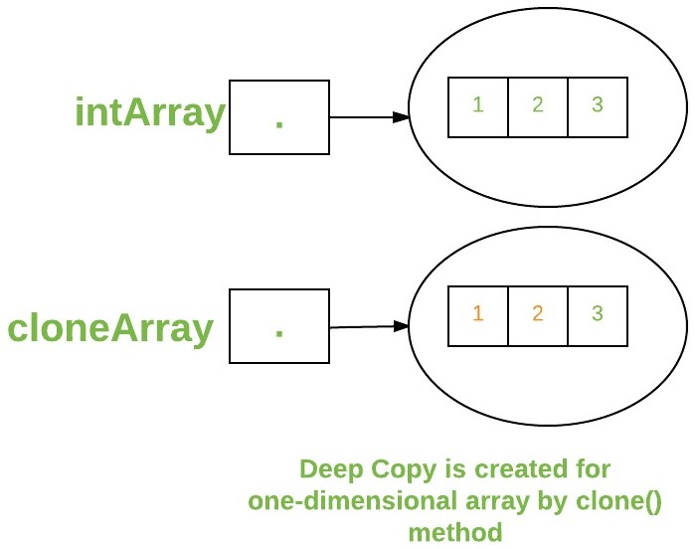
Deep copy is created for ID array

Slide 32
Cloning of 2D Array
A clone of a multi-dimensional array (like Object[][]) is a “shallow copy” however, which is to say that it creates only a single new array with each element array a reference to an original element array, but subarrays are shared.
// Java program to demonstrate cloning of multi-dimensional arrays
class Test
{
public static void main(String args[])
{
int intArray[][] = {{1,2,3},{4,5}};
int cloneArray[][] = intArray.clone();
// will print false
System.out.println(intArray == cloneArray);
// will print true as shallow copy is created
// i.e. sub-arrays are shared
System.out.println(intArray[0] == cloneArray[0]);
System.out.println(intArray[1] == cloneArray[1]);
}
}
Output:
false
true
true

Slide 33
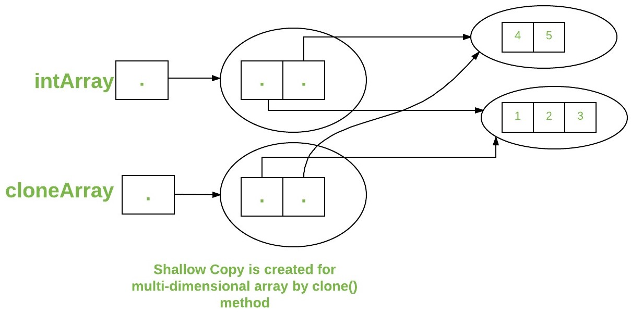
Shallow copy created for 2D array

Slide 34
Assignment for Practice
WAP in which prompt the user to enter the number of subjects and number of CA in each subject.
Read the marks of each CA and store in a two-dimensional array.

Slide 35
Q1
Which of these is the correct syntax for array creation?
a) int arr[] = new arr[5]
b) int [5] arr = new int[]
c) int arr[5] = new int[]
d) int arr[] = new int [5]
Notes:
Ans:d

Slide 36
Q2
Which of these is an incorrect Statement?
a) It is necessary to use new operator to initialize an array
b) Array can be initialized using comma separated expressions surrounded by curly braces
c) Array can be initialized when they are declared
d) None of the mentioned
Notes:
Ans:a

Slide 37
Q3
What will be the output of the following Java code?
class array_output
{
public static void main(String args[])
{
int array_variable [] = new int[10];
for (int i = 0; i < 10; ++i)
{
array_variable[i] = i;
System.out.print(array_variable[i] + " ");
i++;
}
}
}
a) 0 2 4 6 8
b) 1 3 5 7 9
c) 0 1 2 3 4 5 6 7 8 9
d) 1 2 3 4 5 6 7 8 9 10
Notes:
Ans:a

Slide 38
Q4
What will be the output of the following Java code?
class evaluate
{
public static void main(String args[])
{
int arr[] = new int[] {0 , 1, 2, 3, 4, 5, 6, 7, 8, 9};
int n = 6;
n = arr[arr[n] / 2];
System.out.println(arr[n] / 2);
}
}
a) 3
b) 0
c) 6
d) 1
Notes:
Ans:d

Slide 39
Q5
What will be the output of the following Java code?
class array_output
{
public static void main(String args[])
{
int array_variable[][] = {{ 1, 2, 3}, { 4 , 5, 6}, { 7, 8, 9}};
int sum = 0;
for (int i = 0; i < 3; ++i)
for (int j = 0; j < 3 ; ++j)
sum = sum + array_variable[i][j];
System.out.print(sum / 5);
}
}
a) 8
b) 9
c) 10
d) 11
Notes:
Ans:b

Slide 40
Q6(Output??)
public class Main
{
public static void main(String[] args) {
int a[][]=new int[2][2];
System.out.println(a[0][1]);
}
}
0
1
Compile time error
Run time error
Notes:
Ans:A

Slide 41
Java Enum

Slide 42
Introduction : Enum
Data type that contains fixed set of constants.
It can be thought of as a class having fixed set of constants.
enum constants are static and final implicitly.
It can be used to declare days of the week, Months in a Year etc.

Slide 43
Advantages of Enum
enum improves type safety
enum can be easily used in switch
enum can be traversed
enum can have fields, constructors and methods

Slide 44
Important
Enum can not be instantiated using new keyword because it contains private constructors only.
The enum can be defined within or outside of the class because it is similar to a class.
Every enum constant is always implicitly public static final. Since it is static, we can access it by using enum Name.

Slide 45
Examples…
// enum is declared outside any class
enum Color { RED, GREEN, BLUE; }
class Test {
public static void main(String args[]) {
Color c1 = Color.RED;
System.out.println(c1);
}
}
//Output:RED

Slide 46
values(),valueOf() and ordinal() method
The java compiler internally adds the values(),valueOf() and ordinal() methods when it creates an enum.
values() returns an array containing all the values of the enum.
valueOf() returns the enum constant of the specified string value, if exists
ordinal() each enum constant index can be found, just like array index.

Slide 47
// Working of values(), valueOf() and ordinal() method
// Working of values(), valueOf() and ordinal() method
class Test {
public enum Season {WINTER, SPRING, SUMMER, FALL }
public static void main(String[] args) {
for (Season s : Season.values()) {
System.out.println(s);
}
System.out.println("Value of WINTER is: " + Season.valueOf("WINTER"));
System.out.println("Index of WINTER is: " + Season.valueOf("WINTER").ordinal());
System.out.println("Index of SUMMER is: " + Season.valueOf("SUMMER").ordinal());
}
}
//OUTPUT:
WINTER
SPRING
SUMMER
FALL
Value of WINTER is: WINTER
Index of WINTER is: 0
Index of SUMMER is: 2

Slide 48
Enum with switch
// An enumeration of apple varieties.
enum Apple {Jonathan, GoldenDel, RedDel, Winesap, Cortland}
public class Test {
public static void main(String args[]) {
Apple ap;
ap = Apple.RedDel;
// Use an enum to control a switch statement.
switch (ap) {
case Jonathan:
System.out.println("Jonathan is red.");
break;
case GoldenDel:
System.out.println("Golden Delicious is yellow.");
break;
case RedDel:
System.out.println("Red Delicious is red.");
break;
case Winesap:
System.out.println("Winesap is red.");
break;
}
}
}
// Output: Red Delicious is red.

Slide 49
Java Enumeration are class types
(We can give them constructors, add instance variables and methods etc)
// Use an enum constructor, instance variable, and method.
enum Apple {
Jonathan(10), GoldenDel(9), RedDel(12), Winesap(15), Cortland(8);
private int price; // price of each apple
Apple(int p) { price = p; } // Constructor
int getPrice() { return price; }
}
public class Test {
public static void main(String args[])
{
Apple ap;
// Display price of Winesap.
System.out.println("Winesap costs " +Apple.Winesap.getPrice() +" cents.\n");
// Display all apples and prices.
System.out.println("All apple prices:");
for(Apple a : Apple.values())
System.out.println(a + " costs " + a.getPrice() +" cents.");
}
}
Winesap costs 15 cents.
All apple prices:
Jonathan costs 10 cents.
GoldenDel costs 9 cents.
RedDel costs 12 cents.
Winesap costs 15 cents.
Cortland costs 8 cents.

Slide 50
Key points….
enum can contain constructor and it is executed separately for each enum constant at the time of enum class loading.
We can’t create enum objects explicitly and hence we can’t invoke enum constructor directly.
Every enum constant represents an object of type enum.

Slide 51
Q1(Output??)
enum Season
{
WINTER,SUMMER,SPRING;
}
public class Main
{
public static void main(String[] args) {
Season var;
var=SPRING;
System.out.println(var);
}
}
0
Compile time error
-1
SPRING

Slide 52
Q2(Output??)
enum Flowers
{
SUNFLOWER,JASMINE,LOTUS;
}
public class Main
{
public static void main(String[] args) {
Flowers var[]=Flowers.values();
for(int i=1;i<2;i++)
System.out.println(var[i]);
}
}
JASMINE
LOTUS
SUNFLOWER
1
Notes:
A

Slide 53
Q3(Output??)
enum Colours
{
WHITE,GREEN,RED,YELLOW
}
public class Main
{
public static void main(String[] args) {
System.out.println(Colours.valueOf("YELLOW").ordinal());
}
}
0
1
2
3
Notes:
D

Slide 54
Q4(Output??)
enum Colours
{
WHITE(23),GREEN(78),RED(7),YELLOW(100);
int colour_code;
Colours(int code){
colour_code=code;
}
int get_code(){
return colour_code;
}
}
public class Main
{
public static void main(String[] args) {
System.out.println(Colours.RED.get_code());
}
}
7
0
100
23
Notes:
A

Slide 55
List
interface in the java.util package
represents an ordered collection of elements
allows duplicate elements
mplementations of the List interface are ArrayList, LinkedList, and Vector.
ArrayList: resizable array implementation of the List interface.
It is fast for random access but slower for insertions and deletions in the middle.
LinkedList: A doubly-linked list implementation of the List interface.
Vector: A synchronized implementation of the List interface.
It is thread-safe but generally slower than ArrayList.

Slide 56
Vector
import java.util.Vector;
public class Test {
public static void main(String[] args) {
Vector<String> list = new Vector<>();
list.add("Dog");
list.add("Cat");
list.add("Rabbit");
System.out.println(list); // Output: [Dog, Cat, Rabbit]
}
}

Slide 57
LinkedList
import java.util.LinkedList;
public class Test {
public static void main(String[] args) {
LinkedList<Integer> list = new LinkedList<>();
list.add(10);
list.add(20);
list.add(30);
System.out.println(list); // Output: [10, 20, 30]
}
}

Slide 58
ArrayList
import java.util.ArrayList;
public class Test {
public static void main(String[] args) {
ArrayList<String> list = new ArrayList<>();
list.add("Apple");
list.add("Banana");
list.add("Cherry");
System.out.println(list);
// Output: [Apple, Banana, Cherry]
}
}

Slide 59


